Slide 1
Error Mitigation and Randomized Benchmarking for Quantum Circuits
Rajesh Sathya Kumar

Slide 2
Error Mitigation for NISQ
The Long-term plan in Quantum industry is to design a fault tolerant error corrected Quantum Computers. However, the various error mitigation techniques are developed in the meantime to make use of these NISQ era Quantum Computers for real world applications

Slide 3
Zero Noise Extrapolation (ZNE)
The ZNE method works by assuming that the amount of noise present when a circuit is run on a noisy device is enumerated by a parameter g. Suppose we have an input circuit that experiences an amount of noise g = g0 when executed. Ideally, we would like to evaluate the result of the circuit in the g = 0 noise-free setting.
To do this, we create a family of equivalent circuits whose ideal noise-free value is the same as our input circuit. However, when run on a noisy device, each circuit experiences an amount of noise g = s * g0 for some scale factor s≥1. By evaluating the noisy outputs of each circuit, we can extrapolate to s=0 to estimate the result of running a noise-free circuit.

Slide 4
Unitary Folding
When the scale factor is s=1, the resulting circuit is
V=U†U=I.
Hence, the s=1 setting gives us the original unfolded circuit.
When s=3, the resulting circuit is
VV†V=U†UUU†U†U=I.
In other words, we fold the whole circuit once when =3. Generally, whenever ss is an odd integer, we fold (s−1)/2 times.
The s=2 setting is a bit more subtle. Now we apply folding only to the second half of the circuit, which is in our case given by U†. The resulting partially-folded circuit is
(U†UU†)U=I

Slide 5
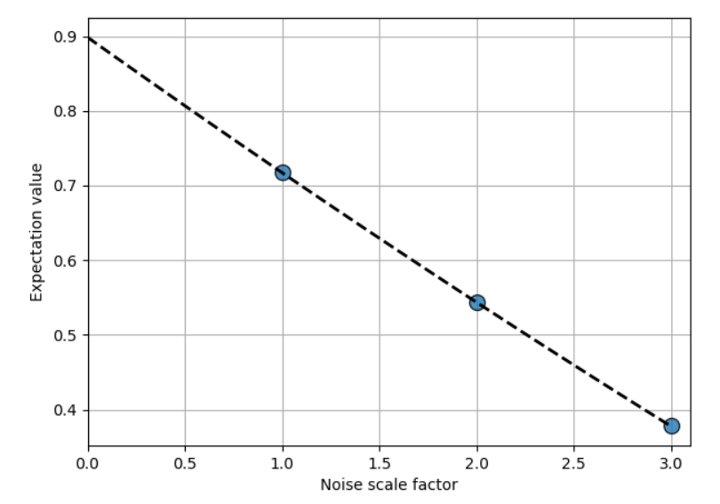
Noise Scaling Factor vs Expectation Value

Slide 6
Intro to Randomized Benchmarking Protocol
Clifford Gates: In quantum computing, the Clifford Group is a set of gates defined by the property that they always transform Pauli’s to Pauli’s. Step 1: Generate RB sequences
Step 2: Execute the RB sequences (with some noise) Step 3: Get statistics about the survival probabilities Step 4: Find the averaged sequence fidelity Step 5: Fit the results

Slide 7
References
T. Proctor, K. Rudinger, K. Young, E. Nielsen, R. Blume-Kohout “Measuring the Capabilities of Quantum Computers”, arXiv:2008.11294 (2020).
K. Temme, S. Bravyi, J. M. Gambetta “Error Mitigation for Short-Depth Quantum Circuits”, Phys. Rev. Lett. 119, 180509 (2017).
Y. Li, S. C. Benjamin “Efficient Variational Quantum Simulator Incorporating Active Error Minimization”, Phys. Rev. X 7, 021050 (2017).
T. Giurgica-Tiron, Y. Hindy, R. LaRose, A. Mari, W. J. Zeng “Digital zero noise extrapolation for quantum error mitigation”, IEEE International Conference on Quantum Computing and Engineering (2020).

Slide 8
Plans next week
Explore more error mitigation methods
Simulation and getting performance of Quantum algorithms after error mitigation

